Slide 1
ANALYSIS OF CUSTOMER REVIEWS ABOUT BRITISH AIRWAYS DATA SOURCE: https://www.airlinequality.com/airline-reviews/british-airways
Submitted by:
Shweta Jain

Slide 2
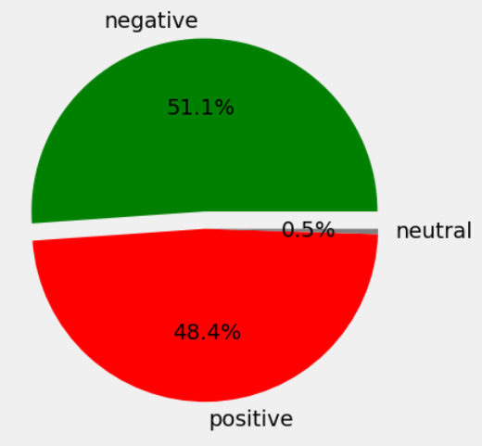
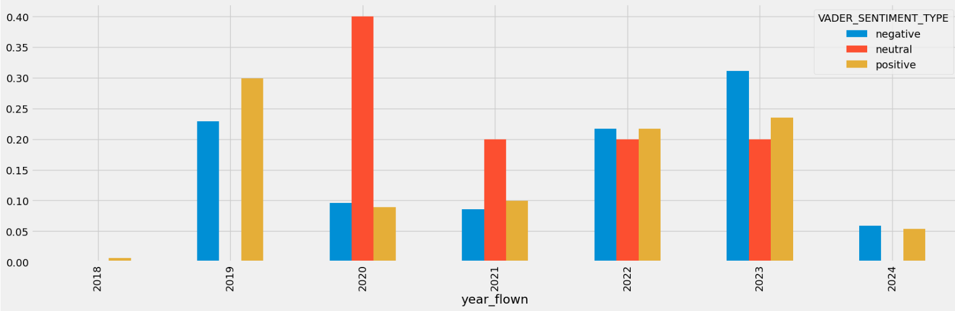
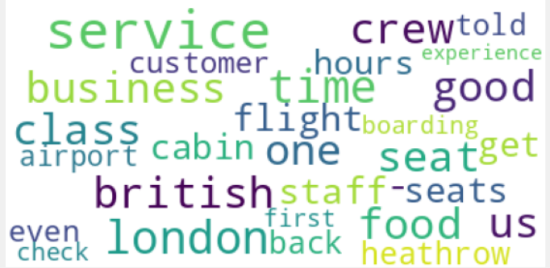
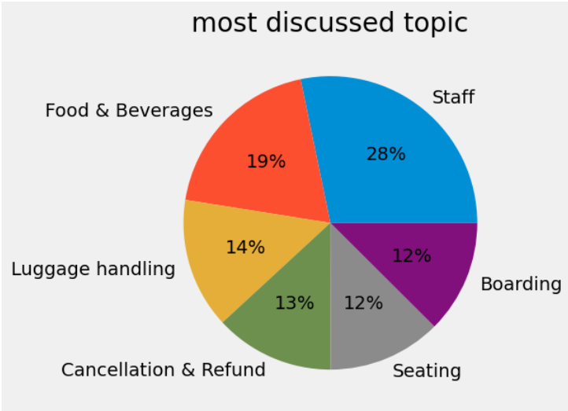
Out of 1000 reviews received over a period of 5 years, overall sentiment is slightly towards NEGATIVE
The negative sentiments peaked in 2023
Most talked about topic has been STAFF that includes both ground staff & cabin crew
Sentiment for each topic
Most frequent terms found in the reviews
TOPIC | SENTIMENT
Staff | Positive
Food & Beverages | Positive
Luggage handling | Negative
Cancellation & Refund | Negative
Seating | Negative
Boarding | Positive

